Slide 1
Backtracking

Slide 2
Backtracking can be defined as a general algorithmic technique that considers searching every possible combination in order to solve a computational problem.
There are three types of problems in backtracking –
Decision Problem – In this, we search for a feasible solution.
Optimization Problem – In this, we search for the best solution.
Enumeration Problem – In this, we find all feasible solutions.

Slide 3
• Express the desired solution as an n-tuple (x1, . . . , xn) where each xi ∈ Si , Si being a finite set
• The solution is based on finding one or more vectors that maximize, minimize, or satisfy a criterion function P(x1, . . . , xn)
Criterion function also called Bounding function
Introduction

Slide 4
Backtracking (animation)
dead end
?
dead end
dead end
?
start
?
?
dead end
dead end
?
success!

Slide 5






1
2
3
4
5
8 | 9 | 7 | 12 | 11
• Sorting an array a[n]
– Find an n-tuple where the element xi is the index of ith smallest element in a
– Criterion function is given by a[xi] ≤ a[xi+1] for 1 ≤ i < n
Set Si ,is a finite set of integers in the range [1,n]

Slide 6
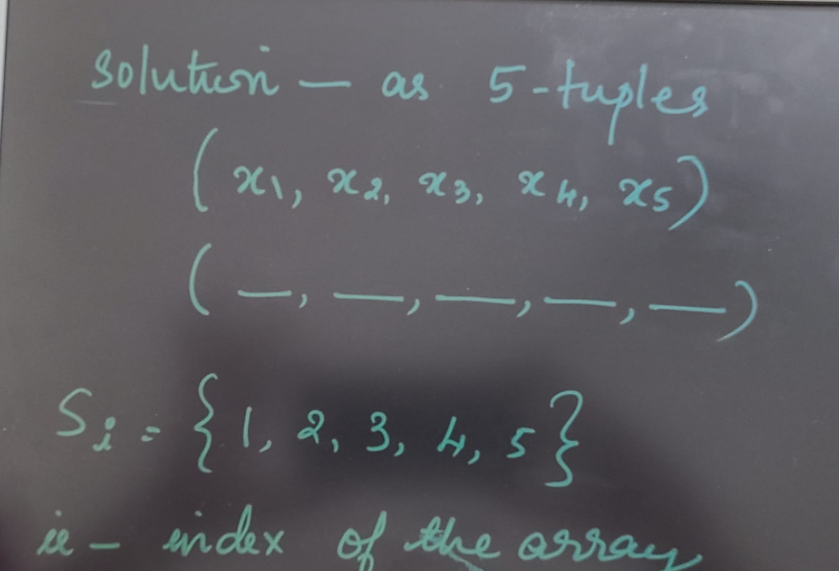

Slide 7
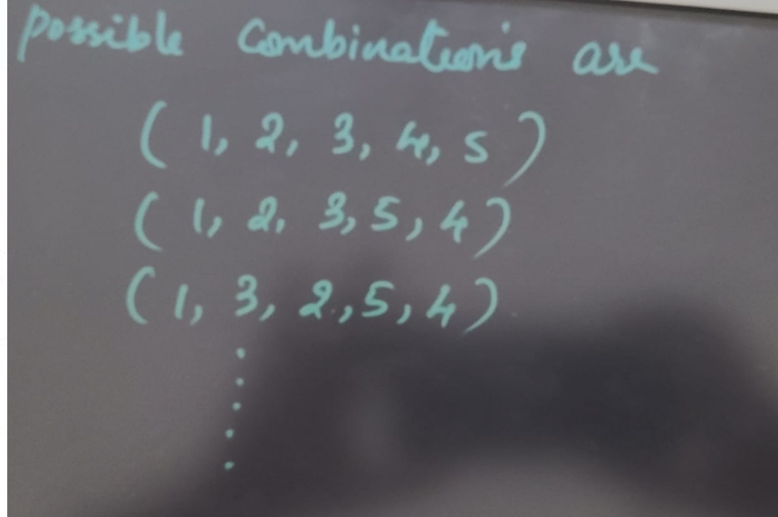

Slide 8
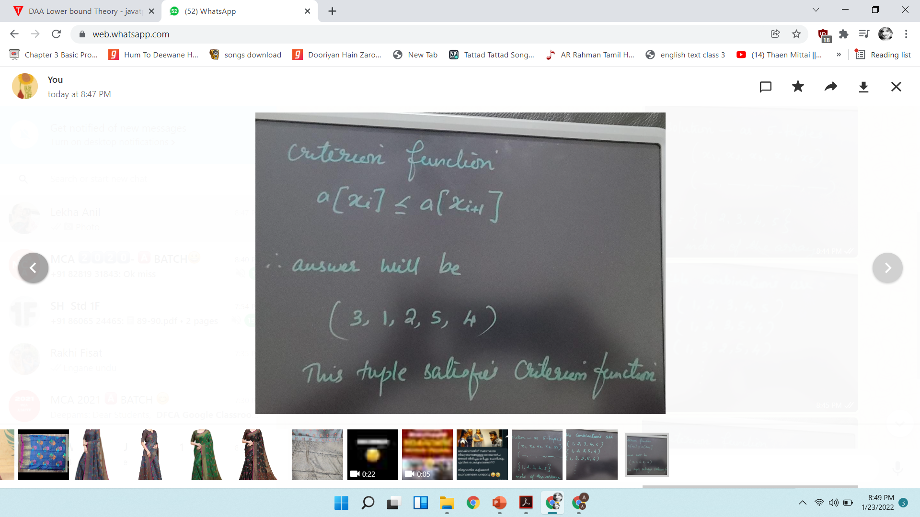

Slide 9
Many of the problems we solve using backtracking require that all the solutions satisfy a complex set of constraints.
• All the solutions require a set of constraints divided into two categories:
explicit and
implicit constraints

Slide 10
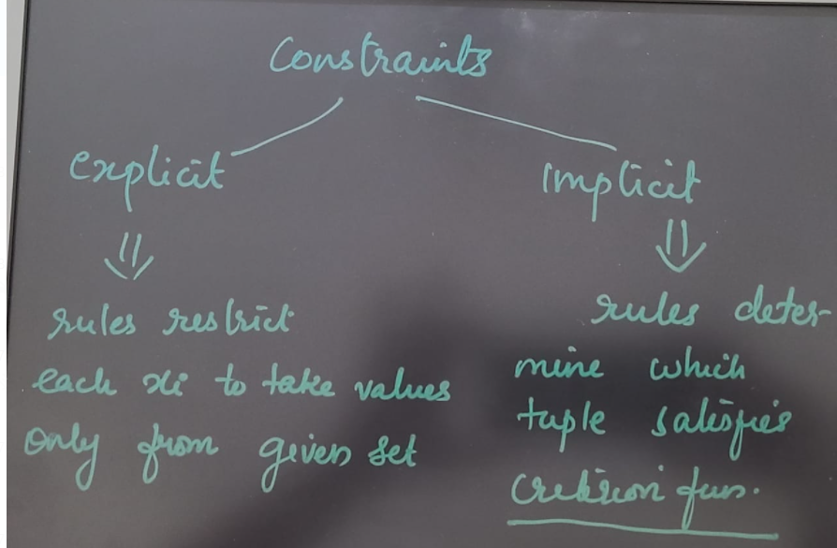

Slide 11
explicit constraints –
are rules that restrict each xi to take on values only from a given set.
– Explicit constraints depend on the particular instance i of problem being solved
– All tuples that satisfy the explicit constraints define a possible solution space for i
– Examples of explicit constraints
∗ xi ≥ 0, or Si=all nonnegative real numbers
∗ xi =0 or 1 or Si= {0, 1}

Slide 12
Implicit constraints –
are rules that determine which of the tuples in the solution space of Si satisfy the criterion function.
Implicit constraints describe the way in which the xi s must relate to each other.

Slide 13
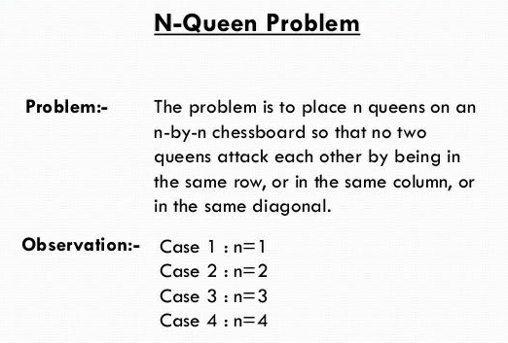

Slide 14
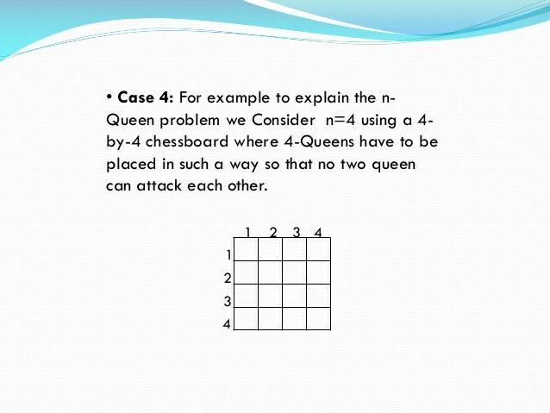

Slide 15
– Place four queens on an 4 × 4 chessboard so that no queen attacks another queen
∗ A queen attacks another queen if the two are in the same row, column, or diagonal
• 4-queens problem

Slide 16
– Identify data structures to solve the problem
Define the chessboard to be a 4 × 4 array
Number the rows and columns 1 through 4
Can number queens 1 through 4
Since each queen must be in different row, assume queen i is placed on i-th row
solution to 4 queens problem represented as 4 tuples (x1, . . . , x4),
where xi is the column on which i th queen placed

Slide 17
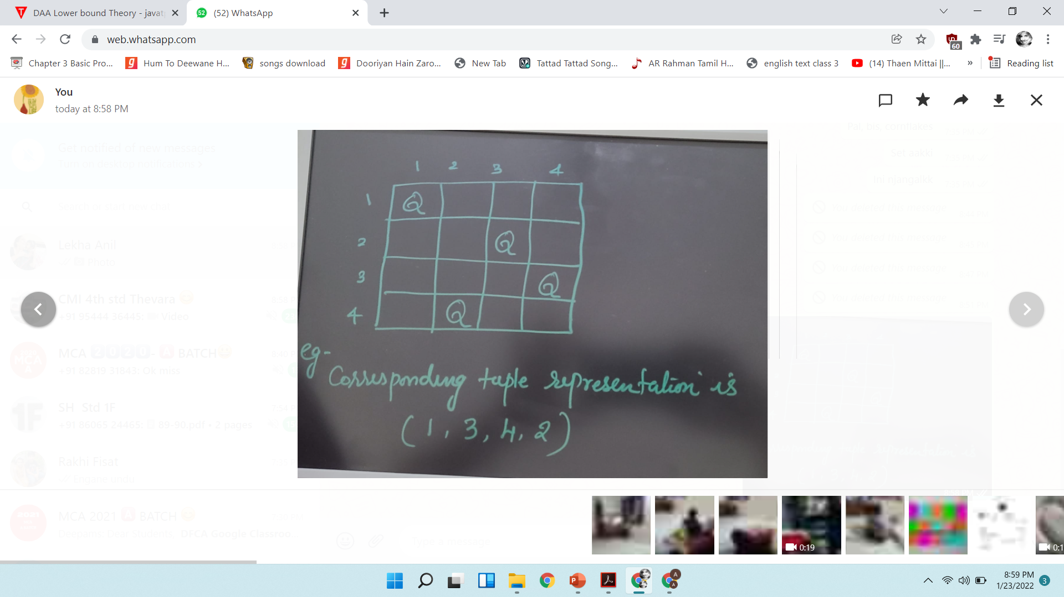

Slide 18
– Identify explicit constraints
∗ Explicit constraints using 4-tuple formulation are Si = {1, 2, 3, 4}, 1 ≤ i ≤ 4
∗ Solution space of 4^4 , 4-tuples

Slide 19
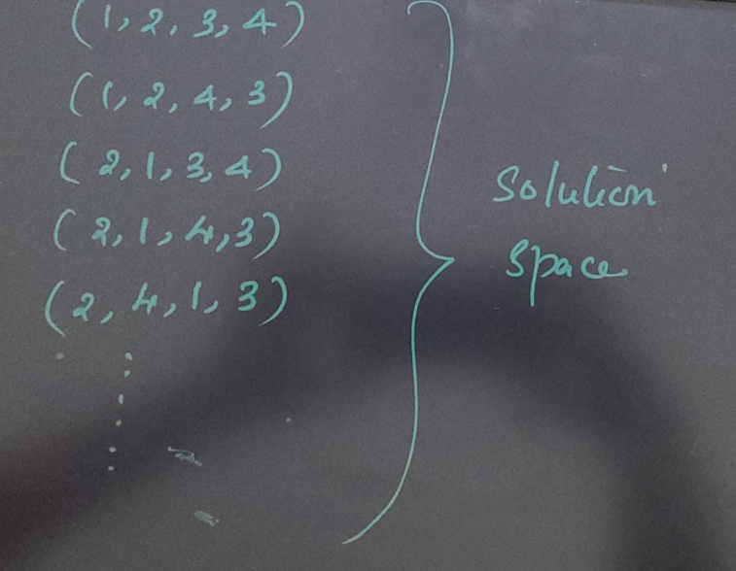

Slide 20
Identify implicit constrants
∗ No two xi can be on the same row, or all the queens must be in different columns and No two queens can be on the same diagonal
* this reduces the size of solution space from 4! tuples

Slide 21
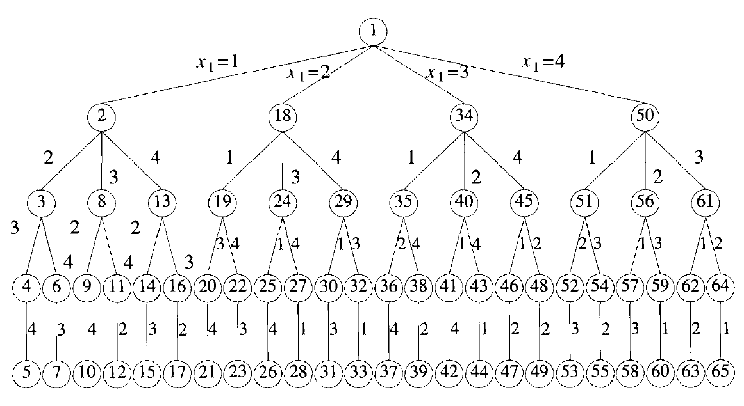

Slide 22
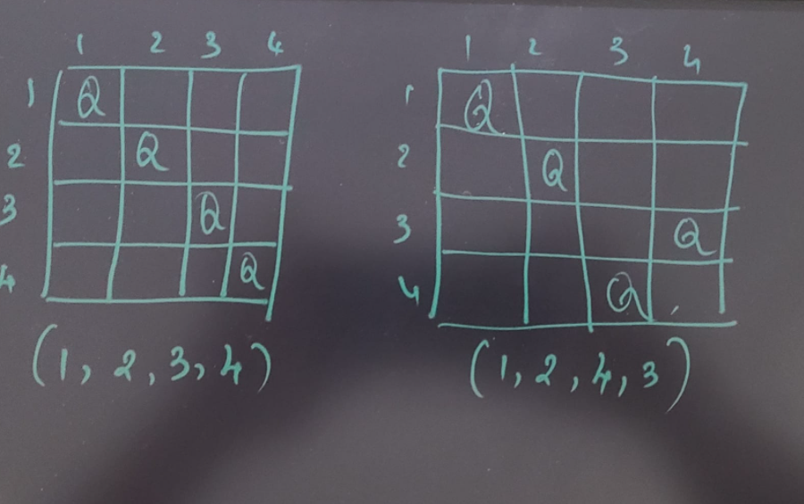

Slide 23
Solution space consist n factorial permutations. Of n tuples (1,2,…,n)
Can show as a tree called permutation tree
Each node in tree defines problem state
All paths from root to other node→ define state space of problem
Leaf nodes are solution states
Tree organization of solution space → state space trees

Slide 24
Searching the solution space for the given problem instance.
This search is facilitated by using a tree organization for the solution space.
For a given solution space many tree organizations may be possible

Slide 26
Live node- node which has been generated and all of whose children have not yet been generated
E node – live node whose children are currently being generated(node being expanded)
Dead node- node which is not to be expanded further or all of whose children have been generated
Bounding functions are used to kill live nodes without generating all their children

Slide 27
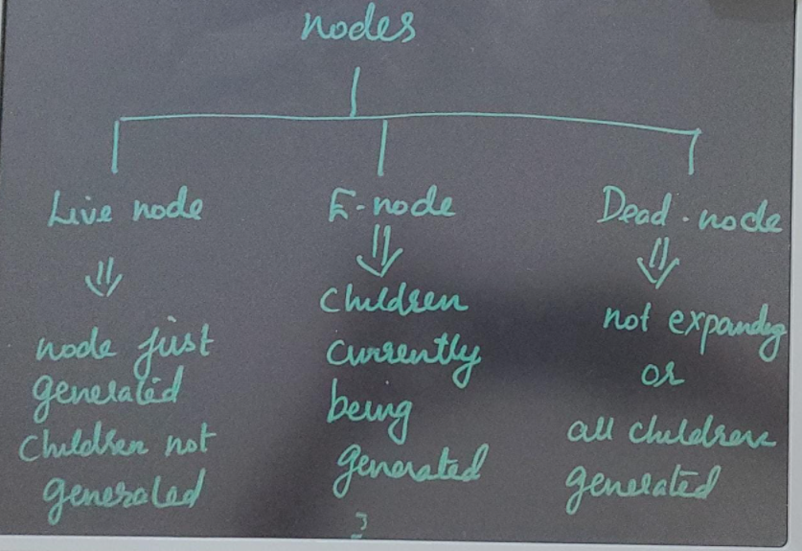

Slide 29
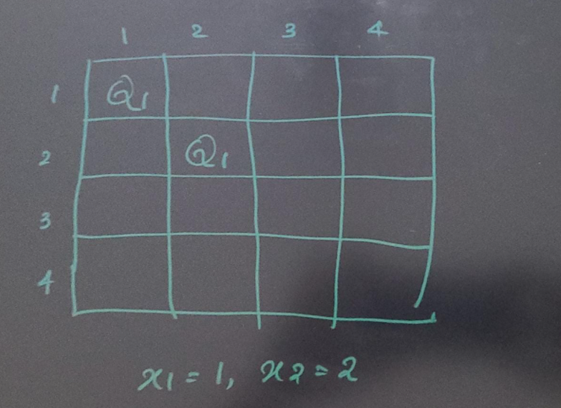

Slide 30
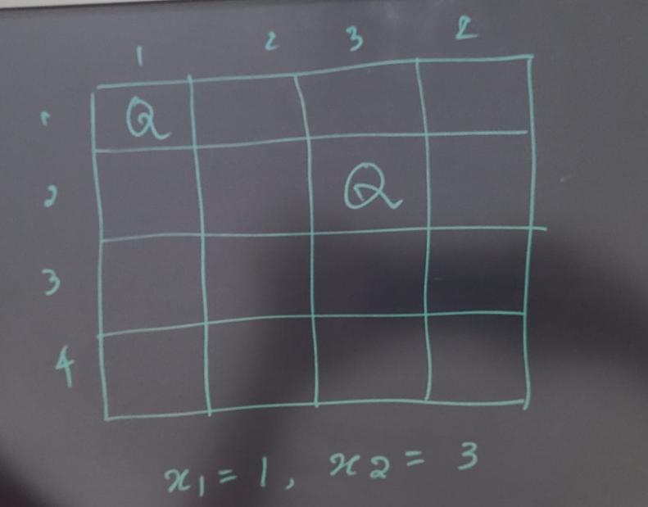

Slide 31
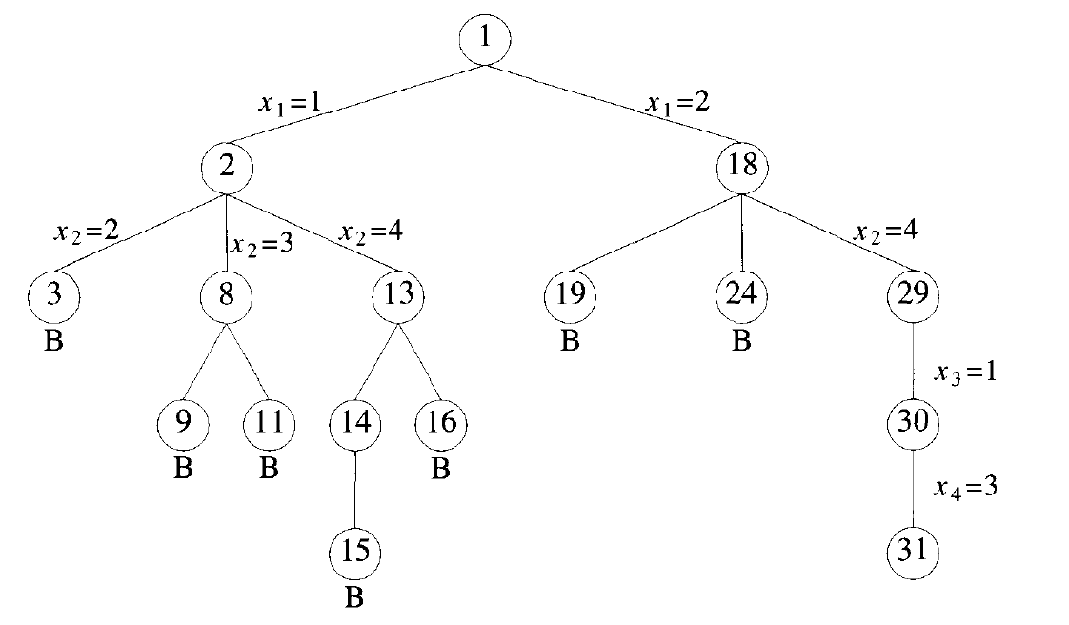

Slide 32
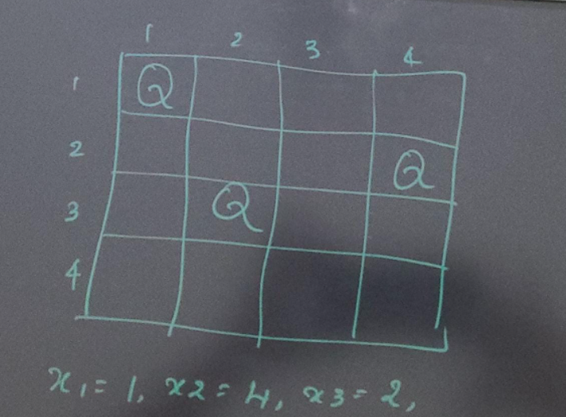

Slide 33
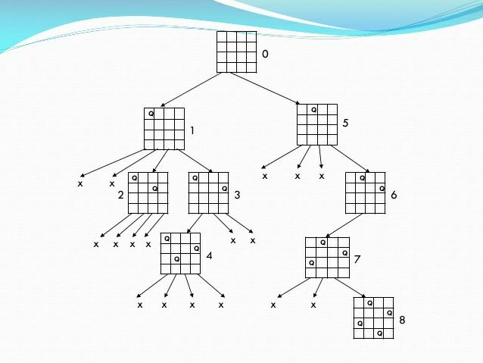

Slide 34
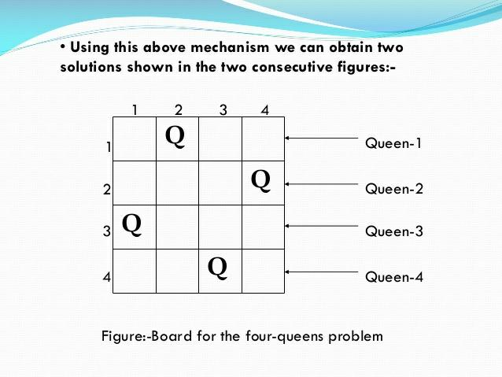

Slide 35
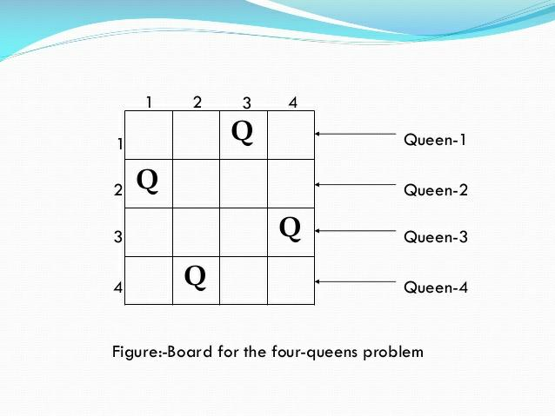

Slide 36
Control Abstraction of Backtrecking

Slide 37
General backtracking algorithm
Let(x1,x2….xi) be a path from the root to a node in state space tree.
T(x1,x2….xi) be a set of all possible values for x(i+1)such that ((x1,x2….xi,xi+1) is also a path to a problem state.
Assume existing bounding function Bi+1 such that Bi+1(x1,x2….xi+1) is false for a path (x1,x2….xi+1) from the root node to a problem state ,that means the path cannot extend to reach answer node

Slide 38
Solution vector(x1,x2….xn ) treated as global array x[1..n]
All possible elements for kth position of tuple that satisfy Bk are generated one by one and joined to current vector
Each time xk attached,check whether solution found
Invoke algorithm recursively

Slide 39
